Slide 1
A Convolutional Neural Network (CNN)
based
Image Classifier
Using Machine Learning

Slide 2

Use Case Description - What we have tried to build
The Image Colourfulness Identification system
The system to identify whether the image is grey or colour (with good sensitivity)
Use Cases:
Use Case #1: Verify whether the image is grey or colour along with the percentage of confidence
Use Case #2: Must identify an image is colour even if the respective image has a small, clear and distinct colour information on it
Use Case #3: Must identify an image is grey even if the respective image has very extremely small degree of colour artefacts in it (not noticeable visually but will/may be computationally)
It automates the identification of the images as colour or grey, which would help the publisher in decision making

Slide 3
Problem Being Solved – the problem that we are solving
Avoid the manual verification of the images as colour or grey
Fully automate the current partial automated process to identify images as colour or grey
Reduce the probability of image misclassification
Reduce the additional cost that an author has to bear due to faulty processing of images
Avoid an additional manual visual checking of each image which would also save the time
Help the publisher in decision making
Help to further automate publishers processing
Classify images with good percentage of confidence

Slide 4
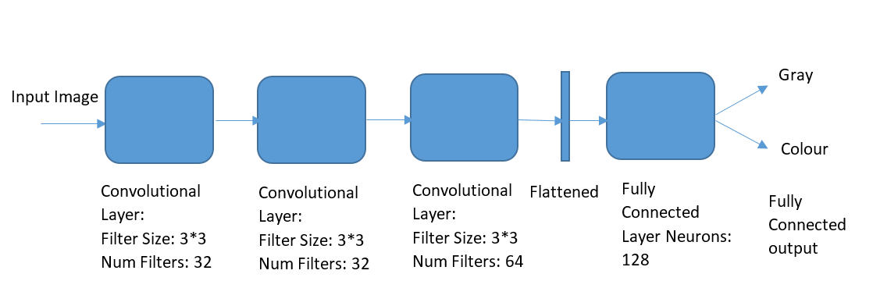
Solution Approach and Architecture

Slide 5
Technology/Tool/Cloud Stack
Machine Learning, Deep Learning
Convolutional Neural Network (CNN)
TensorFlow
Python
OpenCV
Softmax
Shape function

Slide 6
Hardware Specifications
CPUs
GPUs

Slide 7
Demonstration Video/Prototype Demo
GitHub Link
Video Link

Slide 8
Why This Solution Should be Considered
Platform Independent - Runs on verity of platforms - from desktops to clusters of servers to mobile and edge devices
Easy deployment - can run on multiple CPUs, GPUs and TPUs (Tensor processing unit)
System identifies an image is colour or grey along with confidence factor
System identifies grey images with extremely small colour artefacts also as grey with good percentage of confidence
System identifies even images with small, distinct/clear colour information on it as colour with good percentage of confidence
Solution is based on Training Data, Validation Data and Test Data

Slide 9
Challenges Faced
Selecting the solution approach
Deciding the solution model which fits the requirements

Slide 10
Possible Improvements
Select better network design to get more accurate output\predictions
Improve Predictions
Improve Optimizations

Slide 11
References
Machine Learning, Deep Learning
Convolutional Neural Network (CNN)
TensorFlow
Python
OpenCV
Machine Learning Crash Course (MLCC)

Slide 12


